Slide 1
The origin of the generated conversational model
张璐 2019.09.08

Slide 2
Data-Driven Response Generation in Social Media

Slide 3
Goal
Train a phrased-based statistical machine translation model to generate response

Slide 4
Data
1.3 million conversations scraped from Twitter
First two utterances from each conversation

Slide 5
Model
Response Generation as Translation
Ensure r is an appropriate response to s → p(s|r), p(r|s)
Ensure r is a well-formed response → n-gram language model

Slide 6


Challenge
Lexical Repetition
Penalize lexical similarity with Jaccard similarity

Slide 7
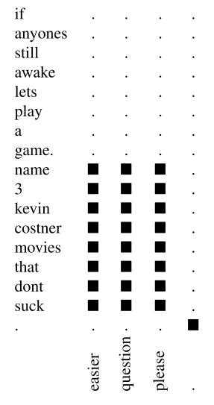
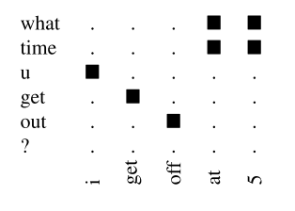
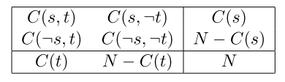

Challenge
Word Alignment
Fisher’s Exact Test → filter out pairs with low correlation
p-value
Notes:
Fisher’s exact test 费希尔精确检验
用于分析列联表（contingency tables）统计显著性检验方法，它用于检验两个分类的关联。虽然实际中常常使用于小数据情况，但同样适用于大样本的情况。

Slide 8
Experiments
Phase-table: 5M phrases with highest association according the Fisher Exact Test statistic
Language model: 1.3M responses from the training data, along with roughly 1M replies collected using Twitter’s streaming API
Use the default feature weights provided by Moses

Slide 9
Result
Human evaluation
Test set: 200 tweets for each experiment
Pairwise comparisons
An appropriate response: on the same topic, make sense

Slide 10
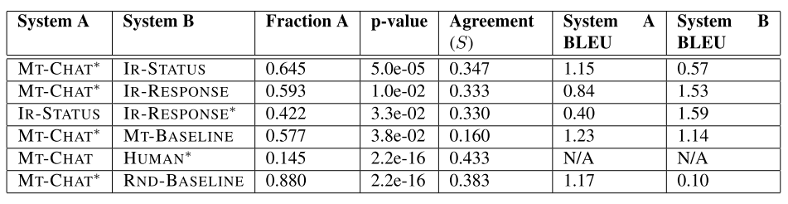
Result
P-value: exact Binomial significance test
S coefficient: a measure of agreement between annotators for each experiment
Automatic Evaluation: BLEU grades an out- put candidate according to n-gram matches to one or more reference outputs
Notes:
二项分布检验：根据
If annotators were indeed choosing randomly, they would be expected to agree in 50% of cases
In most comparisons the value of S is in the range of 0.2 to 0.4, which can be considered “Fair agreement”

Slide 11
Discuss
Much room for improvement
Design appropriate word alignment and decoding algorithm account for the selective nature of response in dialogue
Simply add more training data
One to one vs one to many
Unaligned words/phrases

Slide 12
A Neural Conversational Model

Slide 13
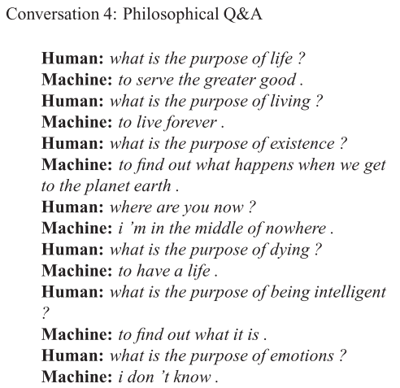

Slide 14
outline
Goal
Dataset
Model
Result
Discuss

Slide 15
Goal
Train an end-to-end data-driven conversational model

Slide 16
Dataset 1
A closed-domain IT helpdesk troubleshooting dataset
Typical interactions are 400 words long
Turn taking is clearly signaled
Training Set: 30M tokens Validation Set: 3M tokens
Process: remove common names, numbers, and full URLs

Slide 17
Dataset 2
An open-domain movie transcript dataset: OpenSubtitles dataset
Noisy and Large
Training Set: 62M sentence/923M tokens Validation set: 26M sentence/395M tokens
Remove XML tags and non-conversational text

Slide 18
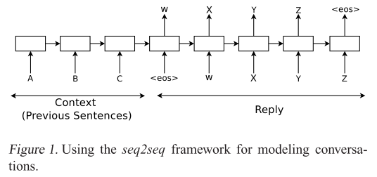
Model
Maximize the cross entropy of the correct sequence given its context
a “greedy” inference approach
Sequence to Sequence Learning with Neural Network
LSTM performs well on long sentences
LSTM learns better when the source sentences are reversed (NMT)

Slide 19
Experiments 1
IT Helpdesk Troubleshooting experiments
A single layer LSTM with 1024 memory cells
Stochastic gradient descent and gradient clipping
Vocabulary: most common 20K words including special tokens indicating turn taking and actor

Slide 20
Experiments 2
OpenSubtitles experiments
A two-layered LSTM with 4096 memory cells
AdaGrad and gradient clipping
To speed up the softmax, project the memory cells to 2048 linear units before feeding the information to the classifier
Vocabulary: most frequent 100K words

Slide 21
Result 1
IT Helpdesk Troubleshooting experiments
Perplexity: 8 n-gram model:18
OpenSubtitles experiments
Perplexity: 17 smoothed 5-gram model: 28
adding the soft attention mechanism did not significantly improve the perplexity on neither training or validation sets

Slide 22
Result 2
Human Evaluation
Four different human were asked to pick which of the two bots they preferred
Allowed to declare a tie if both answers were of equal quality
If three out four human judges agreed, record the score
Model | Win | Lose | Tie | Disagreement | Total
NCM | 97 | 60 | 20 | 23 | 200
CleverBot | 60 | 97 | 20 | 23 | 200

Slide 23
Discuss
Highlight
Generalize to new questions
Remember facts, understand contexts, perform common sense reasoning
Drawbacks
Give simple, short, sometimes unsatisfying answers to questions
the objective function being optimized does not capture the actual objective achieved through human communication, which is typically longer term and based on exchange of information rather than next step prediction.
The lack of a model to ensure consistency and general world knowledge is another obvious limitation of a purely unsupervised model.
Open research problem of designing a good metric to quick measure the quality of a conversational model

